Slide 1
AppDynamics Engineer Training Chapter 6 – Installation – .NET agent Alex Fedotyev Sales Engineer

Slide 2




Agenda
Prerequisites
Installation on Windows
Installation on Window Azure
Questions and problems
Notes:
During this presentation we will go through .NET applications architecture, AppDynamics agent prerequisites, installation process for Windows and Windows Azure and cover some useful questions and problems.

Slide 3
.NET Applications Overview
Windows OS
Internet Information Services
AppDynamics .NET Agent
Web Site
App agent
Web Application
Machine agent
Windows Service
Executable
Notes:
.NET agents monitors all kind of .NET applications whether they are web applications or windows services or even executables.
The agent itself needs to be installed to every Windows server which runs those applications.
Setup is implemented as a standard windows installer package and includes machine agent and application agent components within same installation.
Unlike java installation – for .NET you need to install only one .NET agent whether the server is running one or multiple applications, and then configure the monitoring for the required applications.
Configuration of .NET agent will be explained in details in chapter 7.

Slide 4
Prerequisites
.NET Framework 2.0 or later
Windows 32 or 64 bit
COM+ enabled
Administrator permissions
Notes:
Here is the list of requirements for the .NET agent to be installed:
.NET Framework 2.0 or later – we support every framework up to the latest 4.5 version
There are two versions of the agent installer (two different MSI files) to be used on 32 and 64 bit OS instances. For example, user will haveto install 64bit agent on 64bit OS even if the application itself is running in 32bit mode; 64 bit agent provides the monitoring for both 64 and 32 bit applications.
COM+ needs to be enabled on the server – usually it is enabled by default
Administrative permissions are required to run the installer

Slide 5
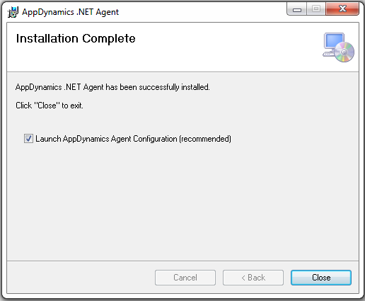
Installation on Windows
Download the .NET agent setup
dotNetAgentSetup.msi (32 bit)
dotNetAgentSetup64.msi (64 bit)
Run the installer
Set the installation folder
Configure the agent
Notes:
Here are the installation steps for the .NET agent:
Download proper installer based on the OS version which is either 32 or 64 bit
Run the installer. You may have to run that as administrator, it depends on Windows configuration. To do that please run the command prompt (cmd.exe) as Administrator by using right mouse click on it and start the actual agent msi from that command prompt. Running msi file as administrator is not supported in windows.
During the setup simply set the installation folder which by default points to the Program Files location but user can change if needed
After the setup is finished the installer will prompt to configure the application monitoring – this is explained in chapter 7

Slide 6
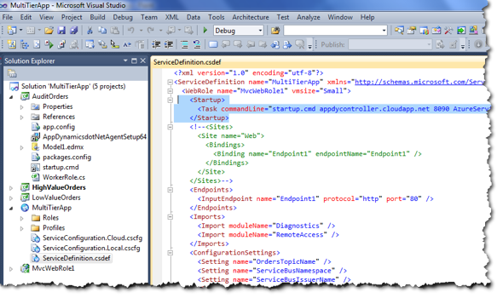
Installation on Window Azure
Installing on Web or Worker role
Add agent MSI to the Azure project
Add startup.cmd that installed the agent
Add startup task that would initiate the install
Install on PaaS - same as on Windows
Notes:
Installation of the .NET agent on Azure is different because of Azure architecture nature itself.
For Web and Worker roles Azure itself supports installing custom packages only through the startup tasks.
To leverage that API user needs to add agent MSI file to the resources of the actual Azure project as well as a startup.cmd script file and an actual startup task.
You can read more about this type of installation at appdynamics.com/azure.
Installing agent on PAAS (platform as a service) is the same as installing on any windows machine using remote desktop connection.

Slide 7
Questions and problems
Enabling COM+
Uninstall and upgrade
Agent configuration files
Notes:
Installation is quite easy and straightforward but there are couple gotcha’s to keep in mind.
First one is about possible errors during the installation due to the COM+ being disabled on the Windows OS.
Second is important to understand how to uninstall the .NET agent and how to upgrade it.
And the last one is about the agent configuration files to understand where the agent stored it’s configuration.

Slide 8
Enabling COM+
Problem symptoms
.NET agent installer fails
Fix – enable & start following windows services
Distributed Transaction Coordinator
COM+ System Application
Notes:
COM+ is required for .NET to be installed and to function correctly.
Most of the installations would run smoothly since COM+ is enabled OOTB but few of them may fail due to COM+ being disabled, specially for old systems.
In case that happens the installer would not be able to complete and return with a failure.
To fix it check the windows services listed here – they need to be enabled and running.

Slide 9
Uninstall and upgrade
Uninstall
Every monitored application would block the uninstall
Disable monitoring, stop or restart the monitored applications and then uninstall agent
Upgrade
Only manual upgrade
First uninstall previous version
Then install new version
Notes:
Uninstall is not the first item you do with the customer, but it is important to understand how that works.
Since the agent DLL’s are physically loaded into the monitored applications processes – those DLL’s won’t let the uninstall work correctly.
There are two options:
Uninstall anyway and keep in mind a pending reboot to do the cleanup (not recommended way)
Better way is to disable monitoring, stop or restart the monitored applications like IIS and then uninstall the agent.
Upgrade is not supported as a pure upgrade scenario yet. In order to upgrade users need to uninstall the previous version of the agent and then install the new one.

Slide 10
Agent configuration files
Machine agent
[InstallFolder]\Machine Agent\Configuration\application.config
Global configuration (optional)
[InstallFolder]\AgentGlobalConfig.xml
Application configuration (optional)
Stored within the application configuration files (web.config or app.exe.config)
Logging configuration
[InstallFolder]\AppDynamicsAgentLog.config
Notes:
Knowing where the agent configuration files are located might be useful for troubleshooting and upgrade when you may want to back up the config files and then restore them after upgrade is done.
Basically there are several location for different type of configuration:
Machine agent configuration file is stored in a separate folder
Global configuration may not exist, it is only created for the mode when auto-naming is enabled (see chapter 7)
And application configuration is created only when the auto-naming mode is not used (see chapter 7). But when it is created it is stored inside the actual application configuration, for example for web application this will be web.config file.
Logging configuration defined where the agents will store the log files

Slide 11
Thank You

